Slide 1
Pipe-All Design Exploration Using GA
Experiment Results
1

Slide 2
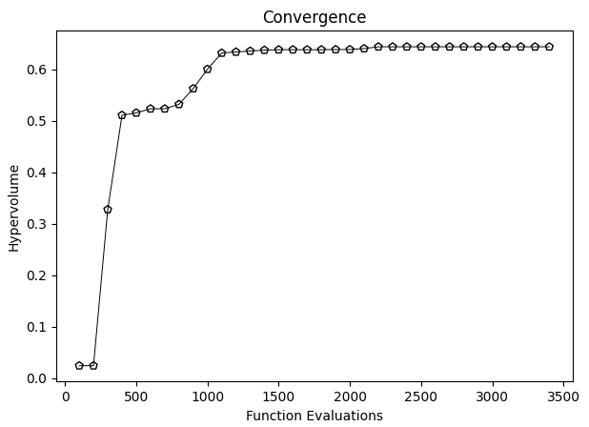
AlexNet
Convergence
2

Slide 3
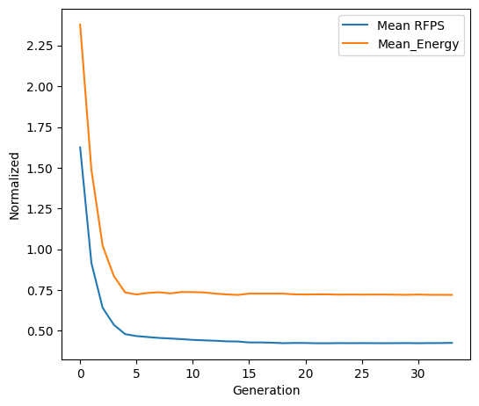
AlexNet
Convergence
AVG energy and time of design points
3

Slide 4
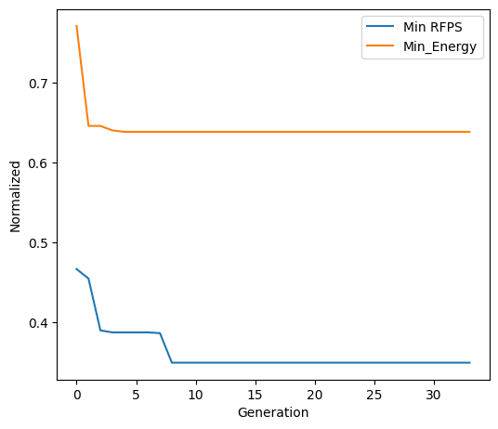
AlexNet
Convergence
Min energy and time of design points
4

Slide 5
AlexNet
Pareto Front Points
X axis is time (1/FPS)
5

Slide 6
AlexNet
Pareto Front Points
X axis is FPS
6

Slide 7
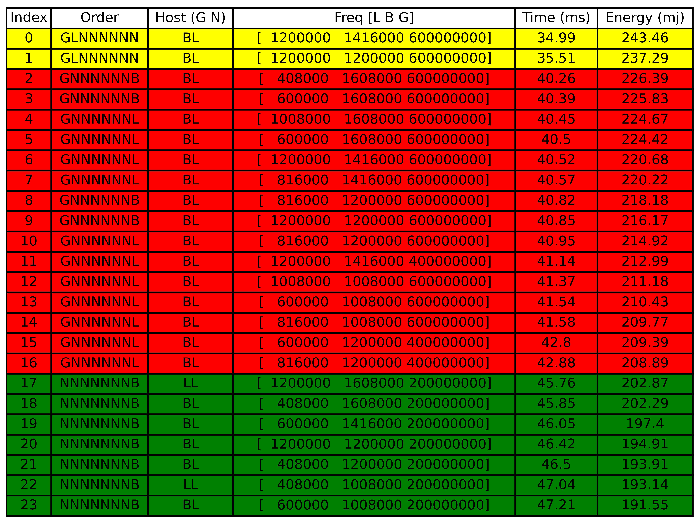
AlexNet
Pareto front design points
Three clusters
7

Slide 8
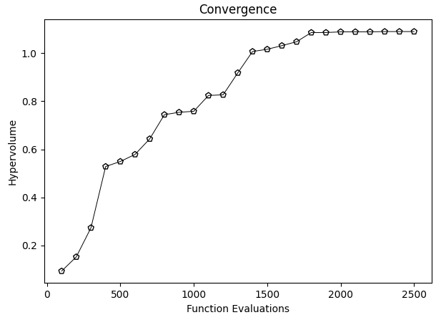
GoogleNet
Convergence
8

Slide 9
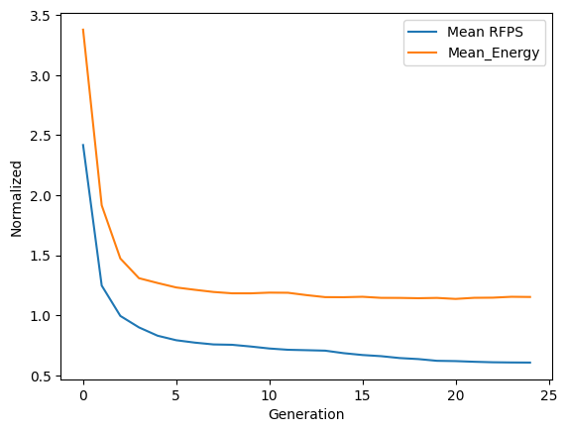
GoogleNet
Convergence
AVG Energy and time of design points
9

Slide 10
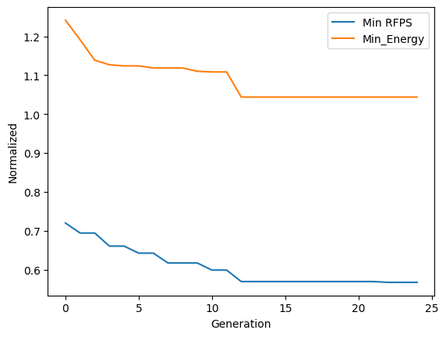
GoogleNet
Convergence
Min Energy and time of design points
10

Slide 11
GoogleNet
Pareto Front Points
X axis is time (1/FPS)
11

Slide 12
GoogleNet
Pareto Front Points
X axis is FPS
12

Slide 13
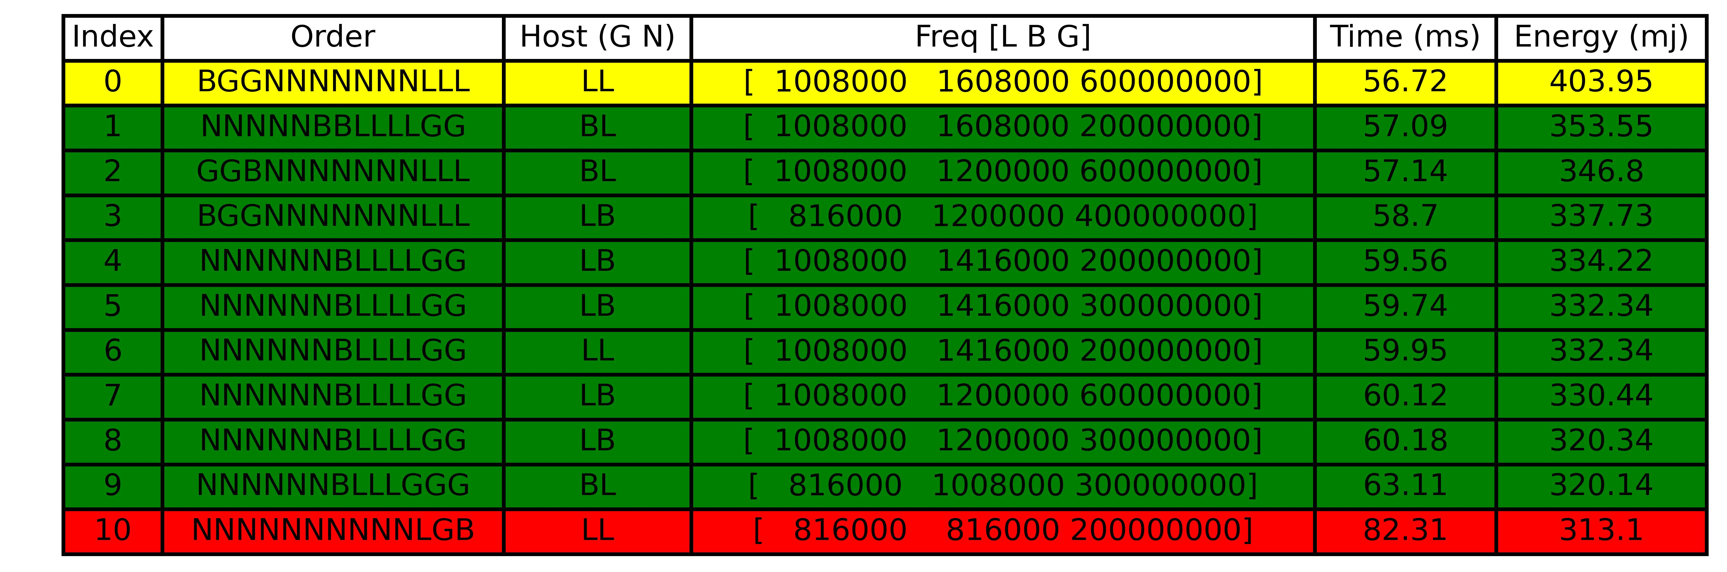
GoogleNet
Pareto front design points
Three clusters
13

Slide 14
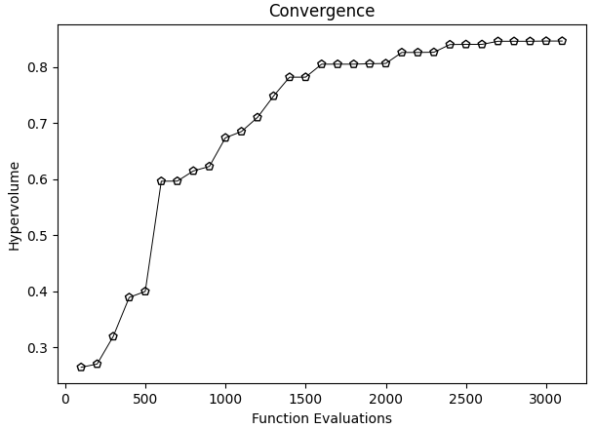
MobileNet
Convergence
14

Slide 15
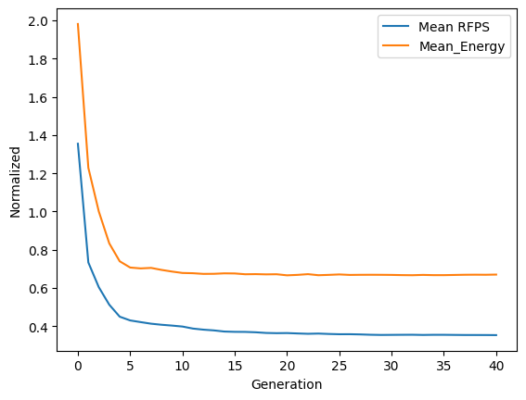
MobileNet
Convergence
AVG energy and time of design points
15

Slide 16
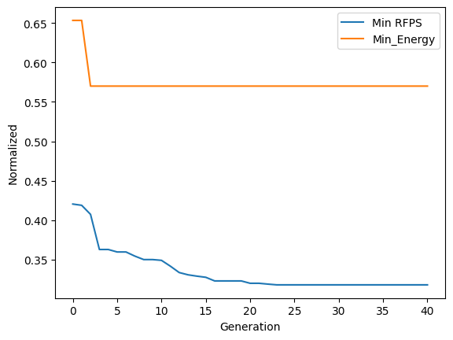
MobileNet
Convergence
Min energy and time of design points
16

Slide 17
MobileNet
Pareto Front Points
X axis is time (1/FPS)
17

Slide 18
MobileNet
Pareto Front Points
X axis is FPS
18

Slide 19
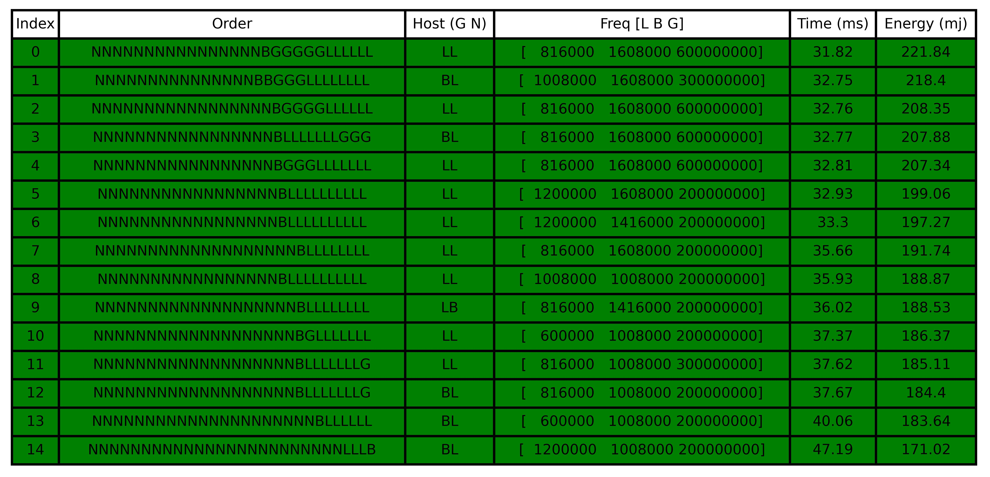
MobileNet
Pareto front design points
19

Slide 20
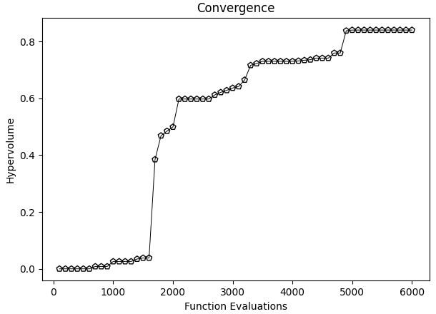
ResNet50
Convergence
20

Slide 21
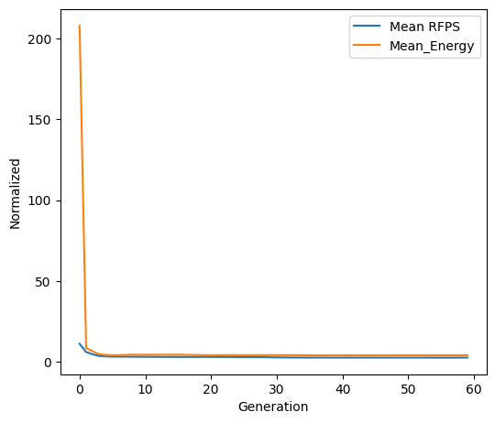
ResNet50
Convergence
AVG energy and time of design points
21

Slide 22
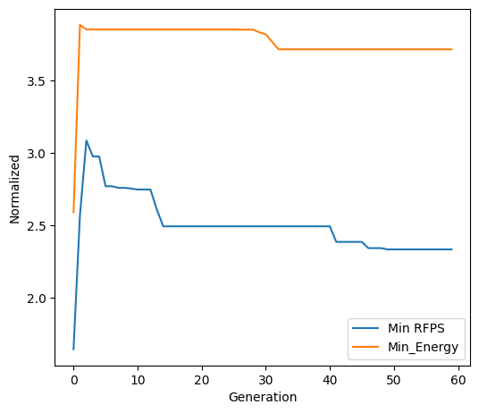
ResNet50
Convergence
Min energy and time of design points
22

Slide 23
ResNet50
Pareto Front Points
X axis is time (1/FPS)
23

Slide 24
ResNet50
Pareto Front Points
X axis is FPS
24

Slide 25
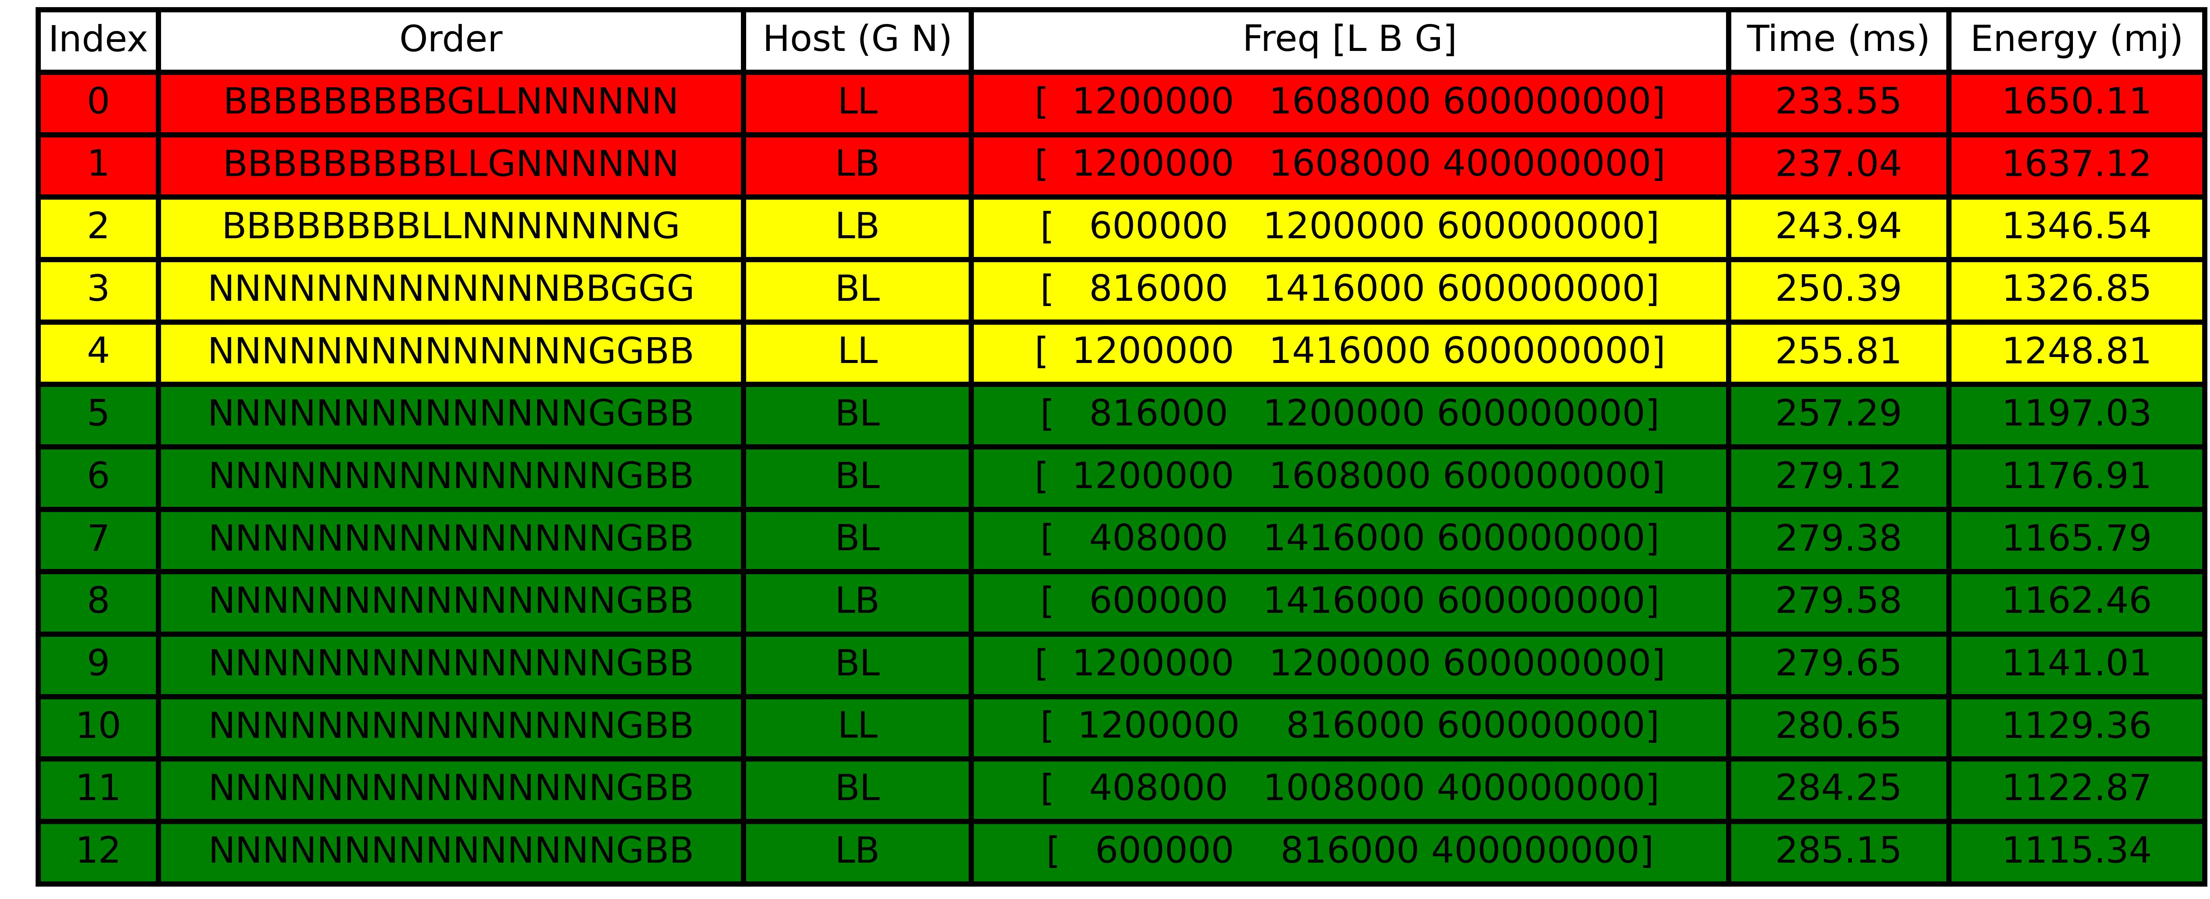
ResNet50
Pareto front design points
Three clusters
25

Slide 26
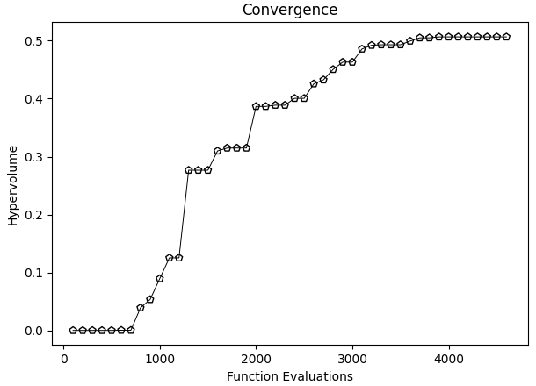
SqueezeNet
Convergence
26

Slide 27
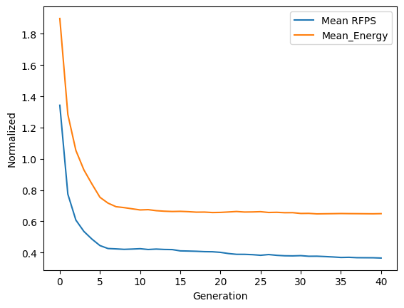
SqueezeNet
Convergence
AVG energy and time of design points
27

Slide 28
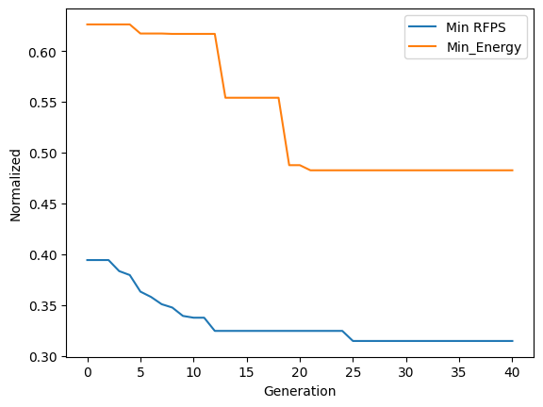
SqueezeNet
Convergence
Min energy and time of design points
28

Slide 29
SqueezeNet
Pareto Front Points
X axis is time (1/FPS)
29

Slide 30
SqueezeNet
Pareto Front Points
X axis is FPS
30

Slide 31
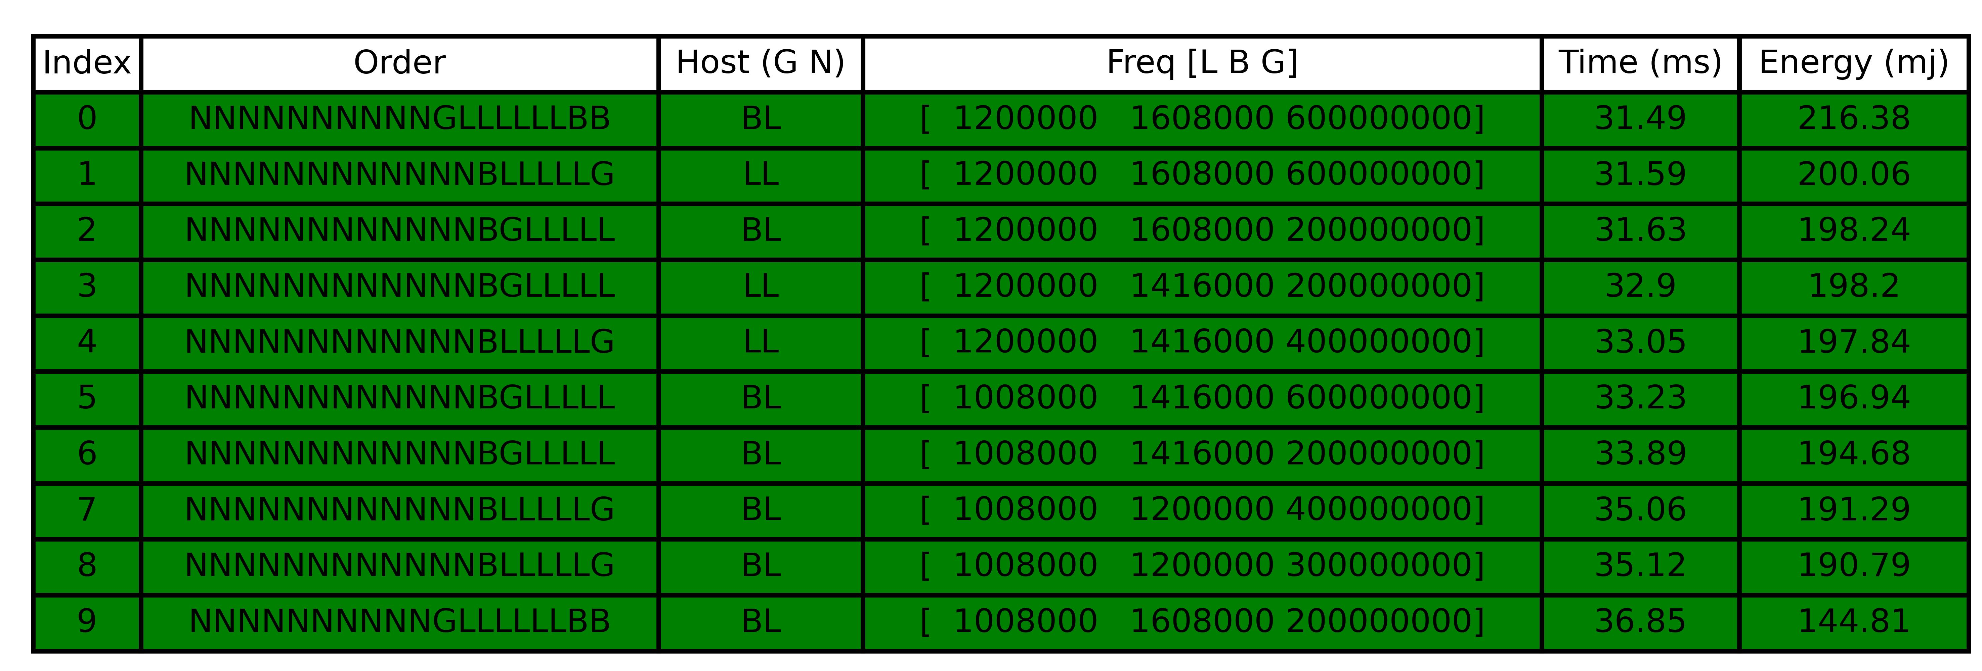
SqueezeNet
Pareto front design points
31

Slide 32
AlexNet
FPS Comparison
32

Slide 33
AlexNet
Energy Comparison
33

